Slide 1
System Variables
PrintNet T

Slide 2

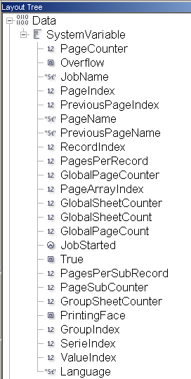
System Variables – Purpose
System Variables are data that PrintNet T
always creates:
  Page counters, indexes
  Job name, Job start time
  Page overflow variable
  Etc.
Notes:
System Variables are stored in the Layout tree under the Data node and are generated for every job, independently of a user’s data.
They are used in many ways – indexes, page counts, page counters, page names, job start times, etc.
The boolean Overflow variable is also placed here – It was presented in Repeated Tables presentation.

Slide 3
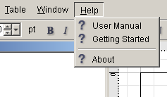
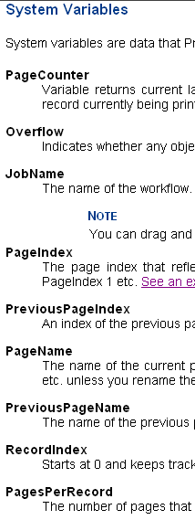
How To Use System Variables
  User manual <F1>
  Search “System Variables”
  How to use
  System Variables Description
Notes:
The User Manual is a recommended source for the information about PrintNet T’s features, including System Variables. System Variables are described in the User Manual one-by-one, and include visual examples.
Search for the string “system variables”.
Trainees can look at the “How to use System Variables”. There are two examples focused on the usage of page counters and counts.
System Variables Description contains list of all System Variables with detailed characterization
To open the User Manual, either press <F1> or go to Menu: Help | User Manual

Slide 4

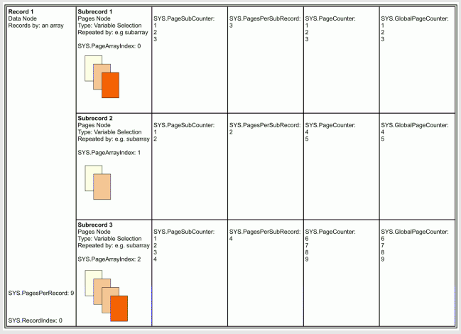
System Variables – User Manual Example
Notes:
This screenshot is taken directly from the User Manual
There are two examples how to use different System Variables in accordance with the different sets of pages
Trainees can see the usage of PageSubCounter, PagesPerSubRecord, PageCounter, and GlobalPageCounter

Slide 5
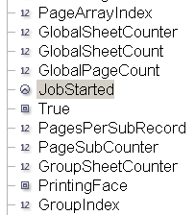




How To Use System Variables
  System Variables in Flow
  Show name or content of the variable in Layout
Notes:
There is an option to show either the variable name or variable content in Layout.
Some variables show only “0” in Layout, so it is sometimes a little bit confusing especially for beginners; showing the Name of the variable may help you to recognize it on the Layout page.

Slide 6

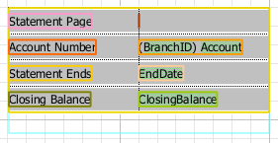
System Variables – Exercise
Put System Variables into the existing document.
  Open SystemVariablesExercise.wfd
  Use correct System Variables to display the page number, and the total number of pages for each customer (consult the User Manual if necessary).
  Proof the job <F6>
  Check the finished job SystemVariablesExerciseDone.wfd
Put the System Variables here
Notes:
The correct System Variables are: PageCounter and PagesPerRecord
Tell the difference between “count” and “counter”

Slide 7

System Variables – Summary
In this presentation we have learned:
  How to:
    Use the User Manual to find information about System Variables
    Find System Variables in the Layout tree
    Put System Variables into flow

Slide 8

System Variables – Discussion
Where can you find System Variables?
What is the purpose of using them?
What is the difference between PageCount and PageCounter?
Is the Overflow variable part of the System Variables?
Notes:
1. Where can you find System Variables?
In the Layout tree, under the Data node.
2. What is the purpose using them?
Create counters, add indexes, page overflow variable
3. What is the difference between PageCount and PageCounter?
PageCount = sum of all pages, PageCounter = ordinal number of the page
4. Is the Overflow variable part of the System Variables?
Yes

Slide 9

Thank You.
Do You Have Any Questions?

